Slide 1

Forest Sentinel AI Solution Type: Prototype
Franck Kasongo
Krishna vamsi Regulavalasa
Shourya Bhardwaj
Notes:
Korrie

Slide 2
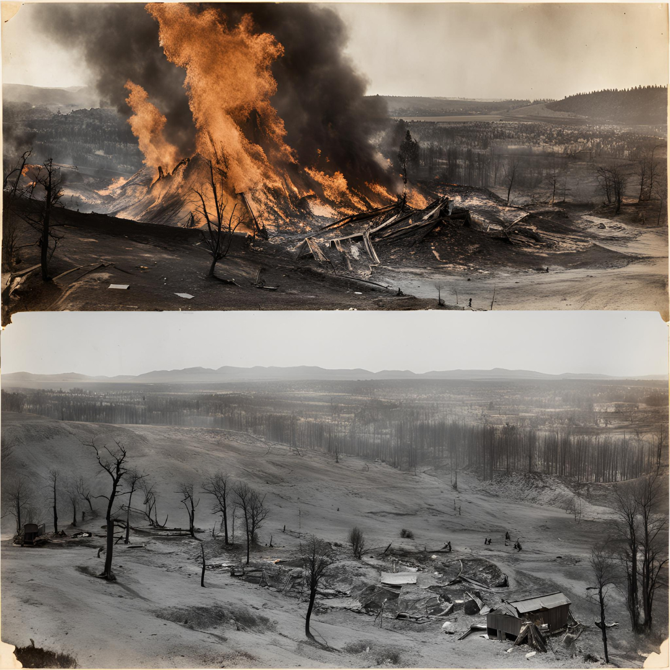
The Opportunity: Understanding Wildfire Recovery in Large Scale Ecosystems
The 1988 Yellowstone Fires: A key event in Yellowstone’s history, burning nearly 800,000 acres and affecting habitats across the park. The fires revealed the park’s resilience, but also posed questions about long-term recovery.
Climate Change Consideration: Increasing wildfire frequency exacerbates ecosystem disruptions. The need for better understanding and proactive monitoring is growing.
Opportunity: Utilizing geospatial technologies, like satellite imagery and AI/ML analysis, can help track vegetation recovery and inform future restoration strategies across vast ecosystems like Yellowstone.
Notes:
Korrie
updated 7/21

Slide 3
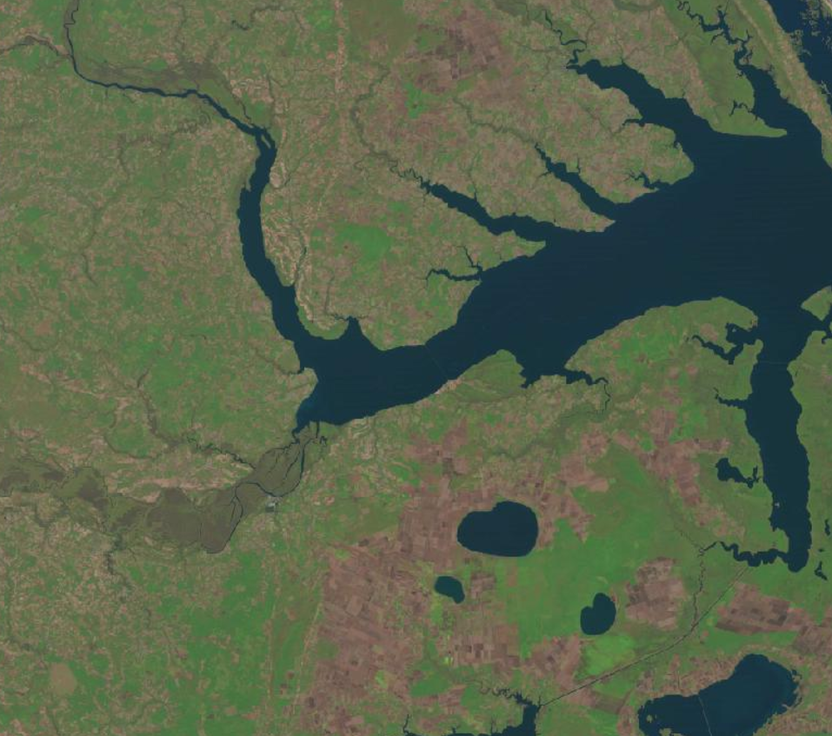
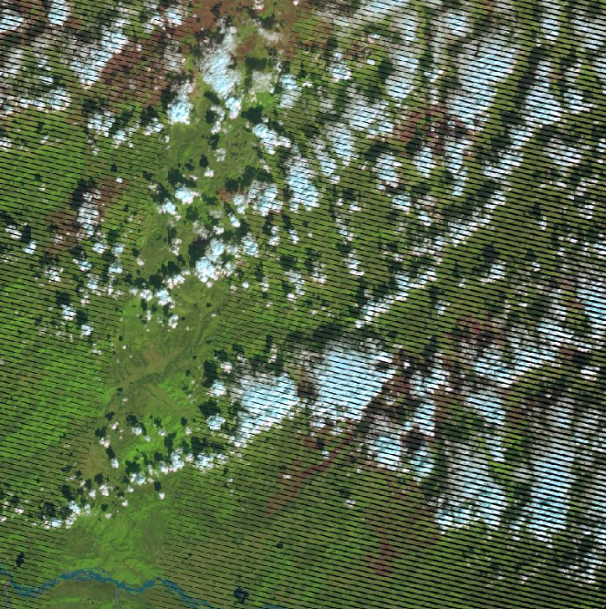
Solution: Prototype Solution for Vegetation Monitoring and Recovery Assessment
Solution Overview:
Data Collection: Landsat satellite imagery was acquired from Earth Explorer to monitor vegetation recovery post-fire.
Data Exploration & Analysis: Using AI/ML models and geospatial analysis tools, we examined NDVI (Normalized Difference Vegetation Index to assess vegetation health and fire severity.
Prototype: We developed an initial prototype to track recovery and provide actionable insights.
Future Potential: While our current analysis offers initial insights, the system can be expanded for ongoing monitoring and predictive modeling.
1988 Natural
Color with
Post-Fire
Burn Scars
Satellite images
Can Have Cloud
Cover and Technical Capture
Issues That Need
to Be Worked
With and Around
Notes:
Korrie
updated 7/21

Slide 4
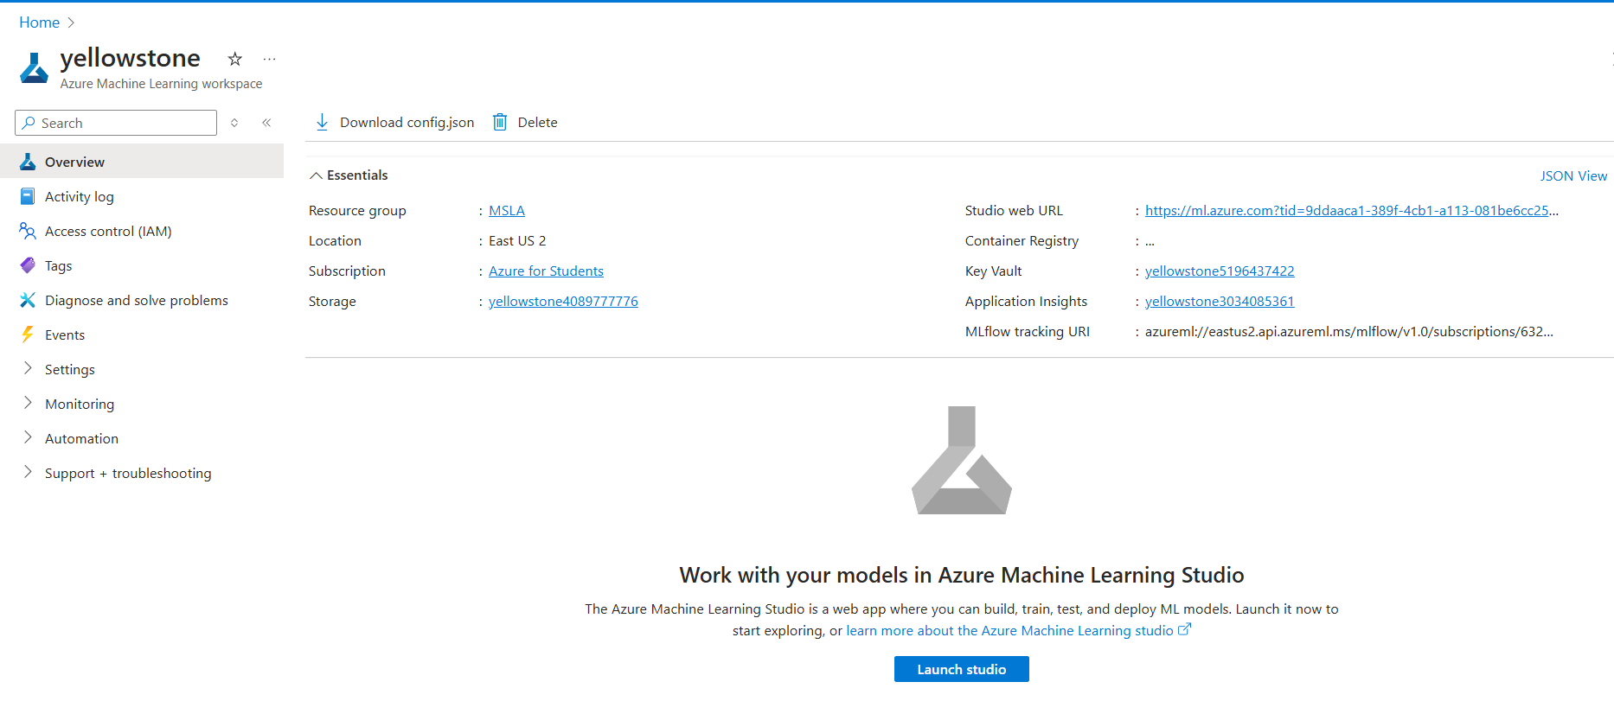
Demo: Azure ML Studio Python Notebook (1 of 5)
Notes:
Korrie
updated 7/21

Slide 5
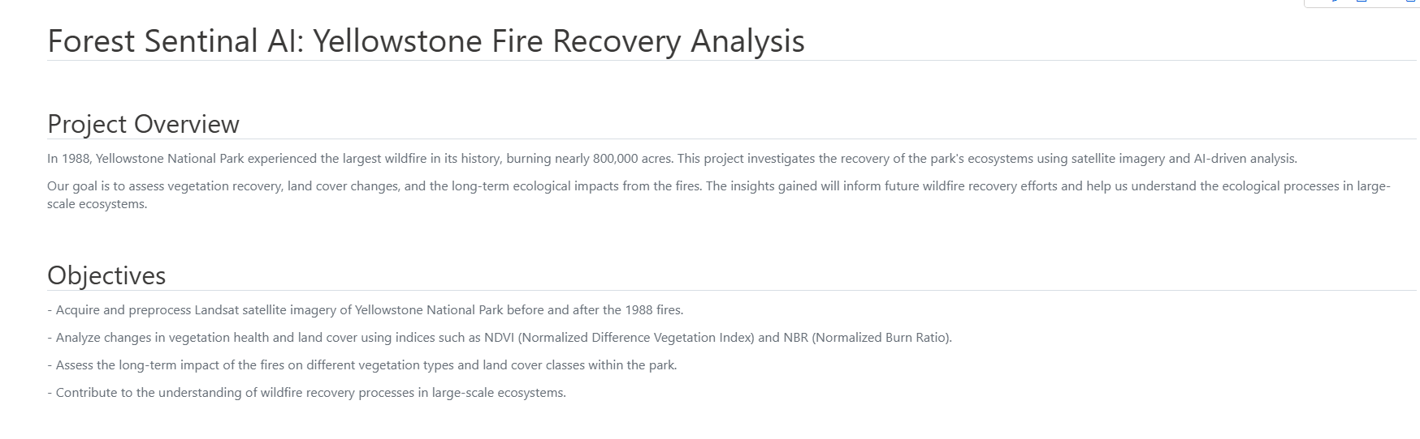
Demo: Azure ML Studio Python Notebook (2 of 5)
Notes:
Korrie
updated 7/21

Slide 6
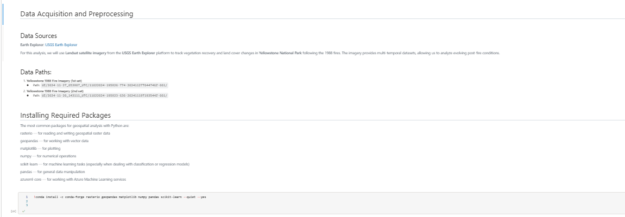
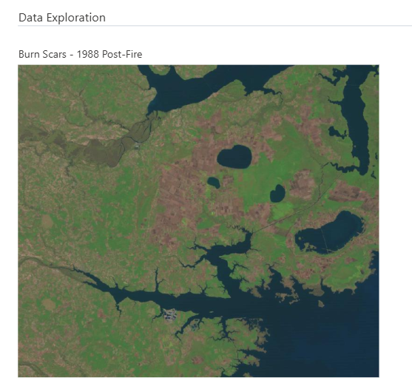
Demo: Azure ML Studio Python Notebook (3 of 5)
Notes:
Korrie
updated 7/21

Slide 7
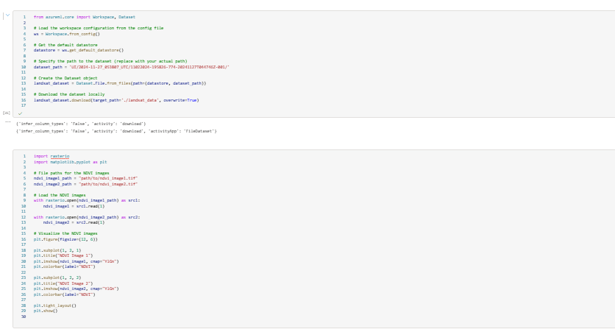
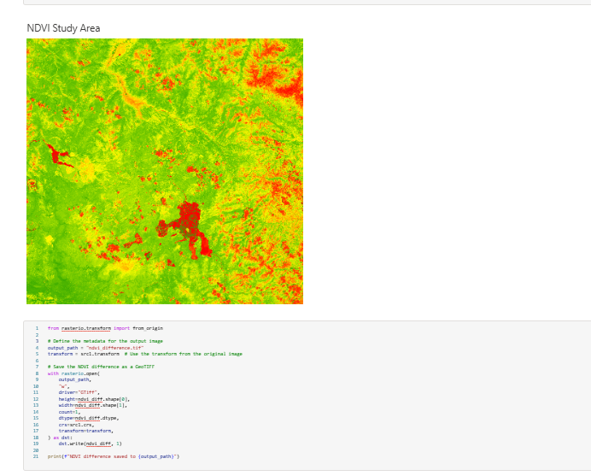
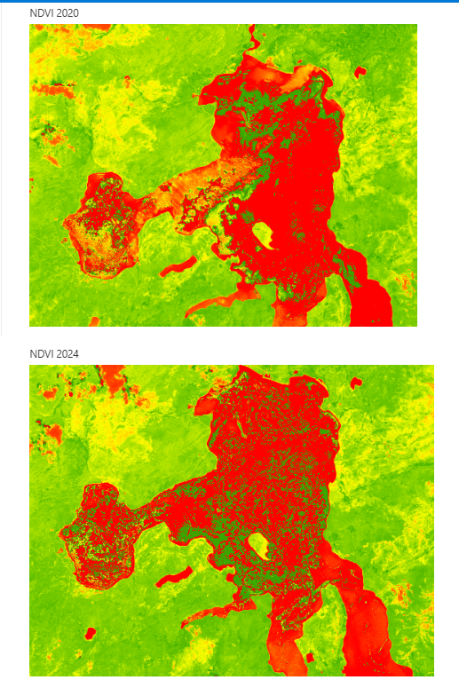
Demo: Azure ML Studio Python Notebook (4 of 5)
Notes:
Korrie
updated 7/21

Slide 8
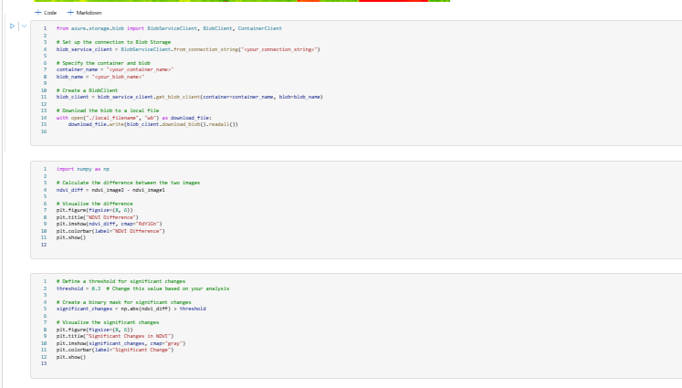
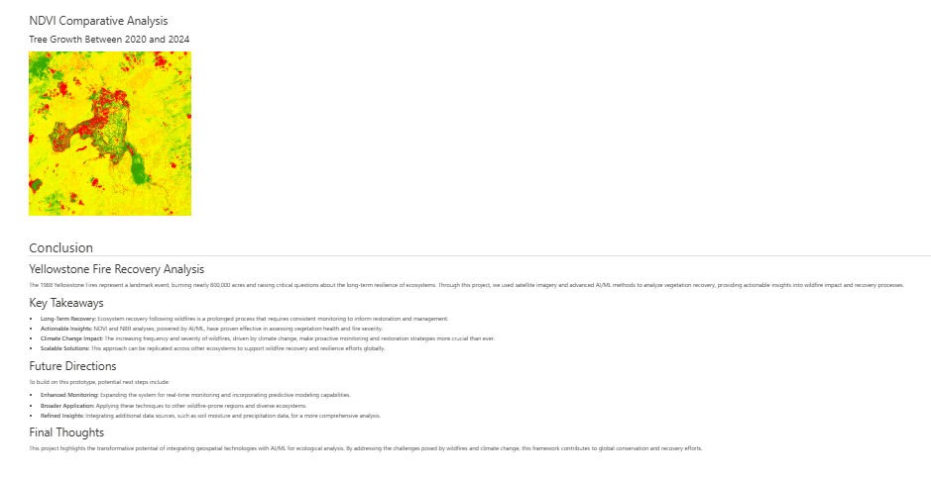
Demo: Azure ML Studio Python Notebook (4 of 5)
Notes:
Korrie
updated 7/21

Slide 9
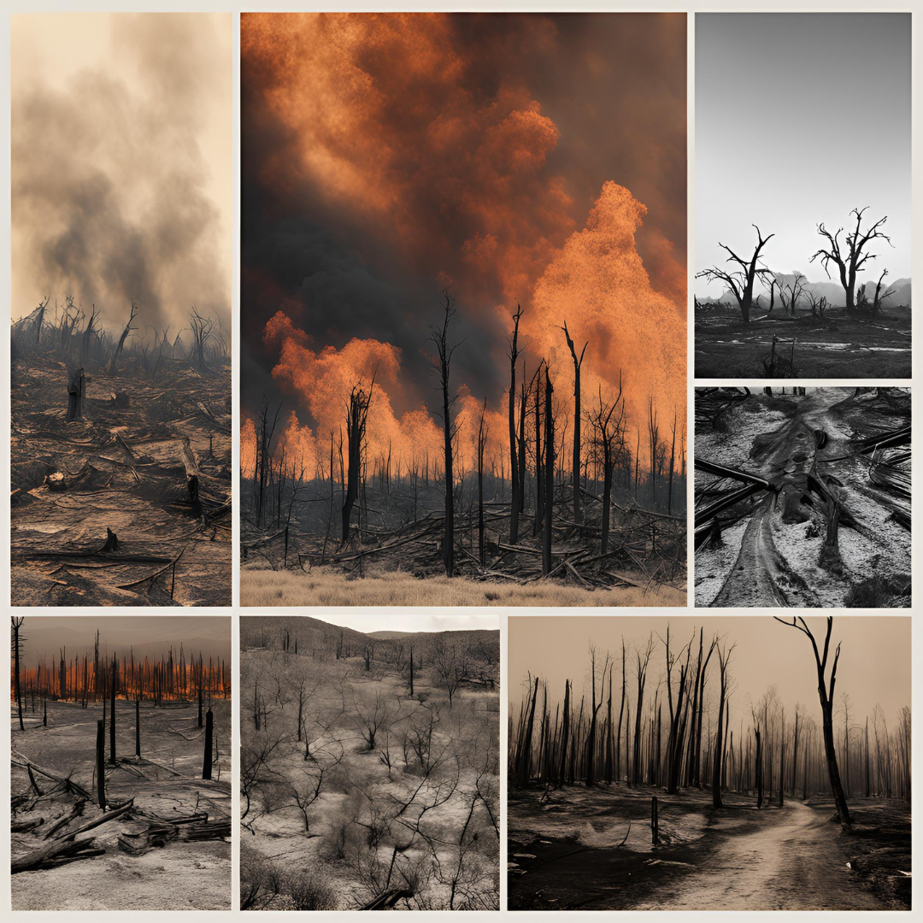
Key Takeaways from the Yellowstone Fire Recovery Analysis
Long-Term Recovery: Wildfire recovery, particularly in vast ecosystems like Yellowstone, is a decades-long process, and real-time monitoring can accelerate decision-making.
Data-Driven Insights: Satellite imagery, AI, and ML tools can be pivotal in guiding restoration efforts and predicting future fire-prone areas.
Climate Change Considerations: Increasing wildfire intensity due to climate change makes data-driven, proactive approaches more critical.
Scalable Solution: This approach can be replicated for other large-scale ecosystems, contributing to wildfire resilience planning and recovery efforts globally.
Notes:
Korrie
updated 7/21

